Slide 1
Mid & Small Virtual ITALY, Virgilio IR
June 27th, 2023

Slide 2
Forward Looking Statement
This presentation may contain forward-looking statements that are subject to risks and uncertainties, including those pertaining to the anticipated benefits to be realized from the proposals described herein. Forward-looking statements may include, in particular, statements about future events, future financial performance, plans, strategies, expectations, prospects, competitive environment, regulation, supply and demand. Esprinet has based these forward-looking statements on its view and assumptions with respect to future events and financial performance. Actual financial performance could differ materially from that projected in the forward-looking statements due to the inherent uncertainty of estimates, forecasts and projections, and financial performance may be better or worse than anticipated. Given these uncertainties, readers should not put undue reliance on any forward-looking statements. The information contained in this presentation is subject to change without notice and Esprinet does not undertake any duty to update the forward-looking statements, and the estimates and the assumptions associated with them, except to the extent required by applicable laws and regulations.

Slide 3
AGENDA
The Company & the Industry
Addressing the Concerns
Exploiting the Opportunities
The Backdrop
Key Strategic Priorities 2022/24
Executive Summary
FY 2022 Results

Slide 4
THE COMPANY & THE INDUSTRY

Slide 5






#1 Tech Enabler in Southern Europe
Esprinet Group is an enabler of the tech ecosystem with a profound calling to social and environmental sustainability.
To promote tech democracy and guide people and firms towards digitalisation, Esprinet offers European clients its expertise in advisory and cybersecurity, as well as a selection of products and services to buy or rent through an extensive network of professional resellers.
20+ years in business,
3 main geographies: Italy, Spain & Portugal
Strong SMB and
mid-market focus
30k customers
Working to provide
the best customer satisfaction
The most complete
Tech product range
with 680 brands
Euronext Milan listed
Esprinet S.p.A. listed on the Italian Stock Exchange in 2001
2022 Sales 4.7 B€
Esprinet S.p.A. undisputed market leader with a strong track record as a consolidator
Consistent Growth
Historical stable flow of profitability: 563 M€ of cumulated Net Profit and 189 M€ of cumulated dividends since 2001
1,800 people
54% female
46% male
Strong Capabilities
130,000 SKUs available
Highly efficient logistics
processes and systems
With +174,000 sqm of warehouses

Slide 6
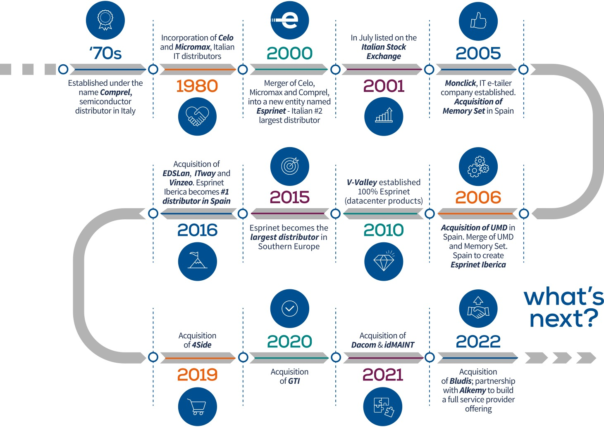
Building the Future on a 20+ Year Legacy

Slide 7



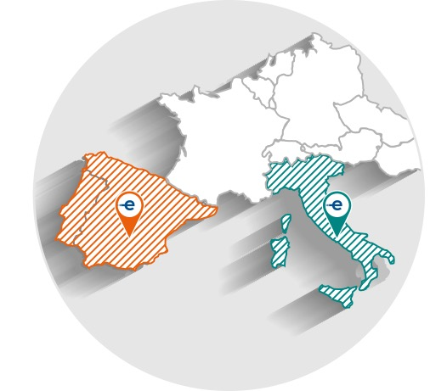
Strong & Leading Market Position
COMPANY | SALES 2022 (M/€) | SHARE
Esprinet | 4,684 | 25% | • | • | •
TD Synnex | 3,858 | 20% | • | • | •
Ingram Micro | 2,426 | 13% | • | • | •
Computer Gross | 2,282 | 12% | •
Arrow ECS | 1,109 | 6% | • | •
Attiva | 592 | 3% | •
MCR | 497 | 3% |  | •
Datamatic | 485 | 3% | •
Exclusive Networks | 274 | 1% | •
CPCDI | 269 | 1% |  |  | •
Inforpor | 212 | 1% |  | •
JP Sa Couto (Also) | 202 | 1% |  |  | •
Depau | 195 | 1% |  | •
Brevi | 185 | 1% | •
Globomatik | 151 | 1% |  | •
DMI Computer | 150 | 1% |  | •
Valorista | 120 | 1% |  | •
Ticnova | 110 | 1% |  | •
Others | 1,305 | 7% | • | • | •
Total (°) | 19,106 | 100%
(°) Based on Company estimates on Context data: conversion from Context panel sales to total distri sales assuming Context Panel represents around 90% of total consolidated distri sales. Adjustment applied to Context panel gross sales of 6.5% (from gross revenue to net revenue).

Slide 8

The Tech Ecosystem: ICT Sector Player
VENDOR producers of Information Technology services and/or products operating under their own brand.
Example: Apple, HP, Lenovo, Dell, Microsoft
DISTRIBUTOR operators providing logistics, storage, credit and marketing services. Distributors can be classified into: • ‘wide-range’ distributors with wide range and high turnover volumes; • ‘specialised’ distributors, the reference point for specific technologies and disciplines.
Example: see the list at pg. 7
RESELLER operators of heterogeneous business models and end-user approach. A distinction is made between: • ‘Professional Resellers’: VARs, Corporate Resellers, System Integrators, Dealers; • ‘Retailers & E-tailers’: GDO/GDS; Online Shops.
Example for IT Reseller: Bechtle, Cancom, Econocom, Altea, Computacenter, Accenture, NTTData; andfor Retailer&E-tailers Ceconomy, Amazon, Auchan, Carrefour, El Cortes Ingles, Worten, Fnac/Darty
END USER end users of technology, which can be classified into: • ‘Individuals’: private consumers; • ‘Small & Medium Business’ companies; • ‘Government & Large Corporations’.

Slide 9

The Tech Ecosystem: ICT Sector Product
SCREENS
DEVICES
SOLUTIONS & SERVICES
PCs
Tablets
Smartphones
Printing
Monitors
Components
Accessories
White Goods
Gaming
Other CE Products
Servers
Storage
Networking
Cybersecurity
Software
Cloud
AutoID
Video Surveillance
Energy & Cabling
Services

Slide 10

The Tech Ecosystem: ICT Sector Route To Market
ROUTE TO MARKET
1
2
3
ITALY-SPAIN-PORTUGAL: TOTAL ICT SPENDING AND SHARE
OF DISTRIBUTORS (EX-WHITE GOODS)
Direct Channel
1st TIER
2nd TIER
Vendor End User
Vendor Reseller End User
Vendor Distributor Reseller End User
in 2022
ICT
19.9 B/€ (53%)
17.8 B/€ (47%)
37.7 B/€
EXISTING ADDRESSABLE
MARKET
White Goods
13.0 B/€ (91%)
1.3 B/€ (9%)
14.3 B/€
POTENTIAL GROWTH
IDC figures for IT Clients - Advanced Solutions & Smartphones - Euromonitor for other Consumer electronics
End-user consumption converted to distri price assuming average 15% margin for resellers/retailers
Conversion from Context panel sales to Total distri sales assuming Context Panel represents around 90% of total consolidated distri sales with differences for product categories
Adjustment applied to Context panel gross sales of 6.5% (from gross revenue to net revenue)
2023 end user market estimates by IDC & Euromonitor as of December 2022
2023 distri sales estimated using a flat growth of 5%
Total
32.9 B/€ (63%)
19.1 B/€ (37%)
52.0 B/€

Slide 11

The Evolution of the Market
For distributors there is a history and a future that speaks of growth
1
2
3
4
5
Innovation - From Analog to Digital: a growing number of digital technologies transforming former analog markets and providing further long-term opportunities for distris.
GDP growth trend in Advanced Economy Countries
GDP & ICT Spending - Digitalization is now a prerequisite for competitiveness of countries: the pandemic has brought ICT to the forefront as a critical enabler. We operate in the three EU Member States with the lowest ratio of ICT spending on GDP and governments are pushing hard to close this gap.
Resilient industry thanks to the strategic role of distribution in the IT value chain. Vendors focusing on winning the IP war and outsourcing everything else. Tech wholesaling is the growing preferred go-to-market strategy of tech manufacturers that look to increase efficiency.
Distributor's ability to gain market share

Slide 12
ADDRESSING THE CONCERNS

Slide 13
The Three Big Concerns of Investor
A middle-man has no reason to exist
Low EBITDA margin is dangerous if revenues fall
A low EBITDA margin company with lots of Working Capital is dangerous
!?
1
!?
2
!?
3
FACTS:
In the last decade distributors share of the go-to-market of vendors grew year after year up to about 50% of the total volumes sold by vendors
The company is a variable cost entity therefore they can withstand huge shifts of its revenues with proportionally low swings in profitability
The industry exists since the early 90s because distributors are running on high quality assets broadly shielded by vendors or credit insurance companies and the losses derived from assets devaluations (excluding impairment losses) are quite rare
Distributors are a good proxy of the Tech Market and represent a rather low-risk way to bet on the overall tech trends without the risk of betting on the single technology or manufacturer
Distributors provide rather stable cash-flows and possibility of dividend pay-outs
Distributors typically don’t require major capital injections if not to fund acquisitions as most of their investments are in Working Capital

Slide 14



1) Why a Distributor
FACT:
THE «WHY» FOR:
FUTURE:
A similar trend towards a “Distributor Friendly” environment is now under development in White Goods
«As a Service» models will require further more the capability of integrating in a single easy-to-use interface for resellers the Consumption models of multiple vendors
Vendors
Reduction of distribution fixed cost
Buffering stock
Credit lines & Credit collection capabilities
Marketing capability
Need of an aggregator of their products into complex multi-vendor solutions
Resellers
Outsourcing of warehousing and shipping on their behalf
One-stop-information gathering point
One-stop-shopping opportunity
Easiness of doing business against dealing directly with vendors
No minimum quantity needed to be a valued partner
Retailers & E-Tailers
“Fulfilment deals” with Vendors on top selling items
Category management for accessories
Home delivery capabilities for White Goods and Large TVs
E-Tailers use Distributors as a one-stop-shopping for the “Long Tail” of products
ICT Distribution share on total ICT addressable sales grew from 40.0% (2016) to 47.0% (2022)
2016 = 40%
2022 = 47%

Slide 15
2) A Flexible P&L and a Well-Funded BS
High resiliency to swings in revenues or margins
Weight of Equity vs. Fixed assets provides vast headroom for working capital management
Low fixed costs provide shield against revenue or gross profit reductions⁽¹⁾
Assuming zero variations of fixed costs the company could withstand up to >40% reduction of revenues or >37% reduction of gross profit before experiencing losses at EBITDA Adj. level.
Ample availability of Net Equity against limited amounts of Invested Capital net of Working Capital provides good headroom to manage working capital seasonality without reverting to bank financing ⁽²⁾.
On average when the company runs at about 20 days of Net Working Capital is cash-neutral (excluding IFRS 16 Lease Liabilities).
 |  | FY 2022 | % | Impact of revenue reduction | % | Delta | Delta %
 | Revenues | 4.684.164 | 100% | 2.769.473 | 100% | -1.914.691 | -40,9%
 | Gross Profit | 244.307 | 5,22% | 144.444 | 5,22% | -99.863 | -40,9%
 | Variable costs | 22.484 | 0,48% | 13.293 | 0,48% | -22.484 | -100,0%
 | Fixed costs | 131.151 | 2,80% | 131.151 | 4,74% | 0 | 0,0%
 | EBITDA Adj. | 90.672 | 1,94% | 0 | 0,00% | -90.672 | -100,0%
 |  | FY 2022 | % | Impact of GP% reduction | % | Delta | Delta %
 | Revenues | 4.684.164 | 100% | 4.684.164 | 100% | 0 | 0,0%
 | Gross Profit | 244.307 | 5,22% | 153.635 | 3,28% | -90.672 | -37,1%
 | Variable costs | 22.484 | 0,48% | 22.484 | 0,48% | 0 | 0,0%
 | Fixed costs | 131.151 | 2,80% | 131.151 | 2,80% | 0 | 0,0%
 | EBITDA Adj. | 90.672 | 1,94% | 0 | 0,00% | -90.672 | -100,0%
(A) Net Equity | 409,2
Fixed assets | 151,6
Other assets & liabilities | -27,8
RoU Assets [IFRS16 ] | 106,9
Lease liabilities [IFRS16] | -112,4
(B) Total Invested Capital ex-NWC | 118,3
(C) Funding available for NWC (A-B) | 291,0
(D) Revenues 2022 | 4.684,2
(E) Funding on Revenues (C/D) | 6,2%
Cash Cycle Days for NFP neutrality (E * 365) | 22,7
Simulations based on 2022 figures – Variable costs are an unaudited management estimate
Balance Sheet figures as of December 31th 2022

Slide 16



3) High Quality Assets
Inventory Risk Mitigants
Factoring & Credit Insurance Policies
Credit Notes
Stock Protection Clause
Provided by the vast majority of Vendors in which they assume the risk of inventory devaluation arising from purchase list price reductions planned by the Vendor itself.
Fulfilment deals stock protection
Vendors might allow the Distributor to purchase products based on a sales forecast agreed upon between the Vendor and the Retailer/Corporate Reseller. Vendors might guarantee the Distributor, either contractually or customarily, that those products will be sold with a predefined margin, essentially shielding the Distributor from the inventory risks that might arise from the need of reducing the sales price or disposing of unsold products.
Stock Rotation Clause
On specific product categories, i.e. software or pre-packaged services, the Distributor is periodically allowed to ship back obsolete stock in exchange of new products of similar value.
Credit insurance
Large and medium sized distributors routinely apply contracts with top-rated Credit Insurance Companies shielding the risk of default of debtors with deductibles typically between 10% to 15% of the insured value.
Factoring/Securitization programs
Trade receivables might be sold “without-recourse” to factoring entities or conduits of a trade receivables securitization program, typically major commercial banks but sometimes Vendor financing companies as well. When factoring/securitization happens, being a true-sale, no deductibles are involved and the credit risk is entirely transferred to the factoring company.
Risk taking
Sometimes distributors might takes some credit risk on their books by issuing a Credit Limit that exceeds the value of the Credit Insurance coverage.
The Industry operates with a significant amount of Credit Notes accruals at any given end-period
Vendors routinely operate with commercial programs that envisage significant amounts of price adjustments for multiple reasons such as:
End-period accruals for target achievements;
Stock protection;
Pass through.
Customers as well are entitled to price adjustments such as:
End-period accruals for target achievements;
Pass through;
Co-marketing funds.
Accounting treatment
At any given quarter-end accruals are made to account for the credit notes pending reception from Vendors and credit notes pending issuing to customers.
Since these are significant and estimated amounts, corrections are possible in particular at the end of the year when most of the reference periods have ended.

Slide 17
EXPLOITING THE OPPORTUNITIES

Slide 18
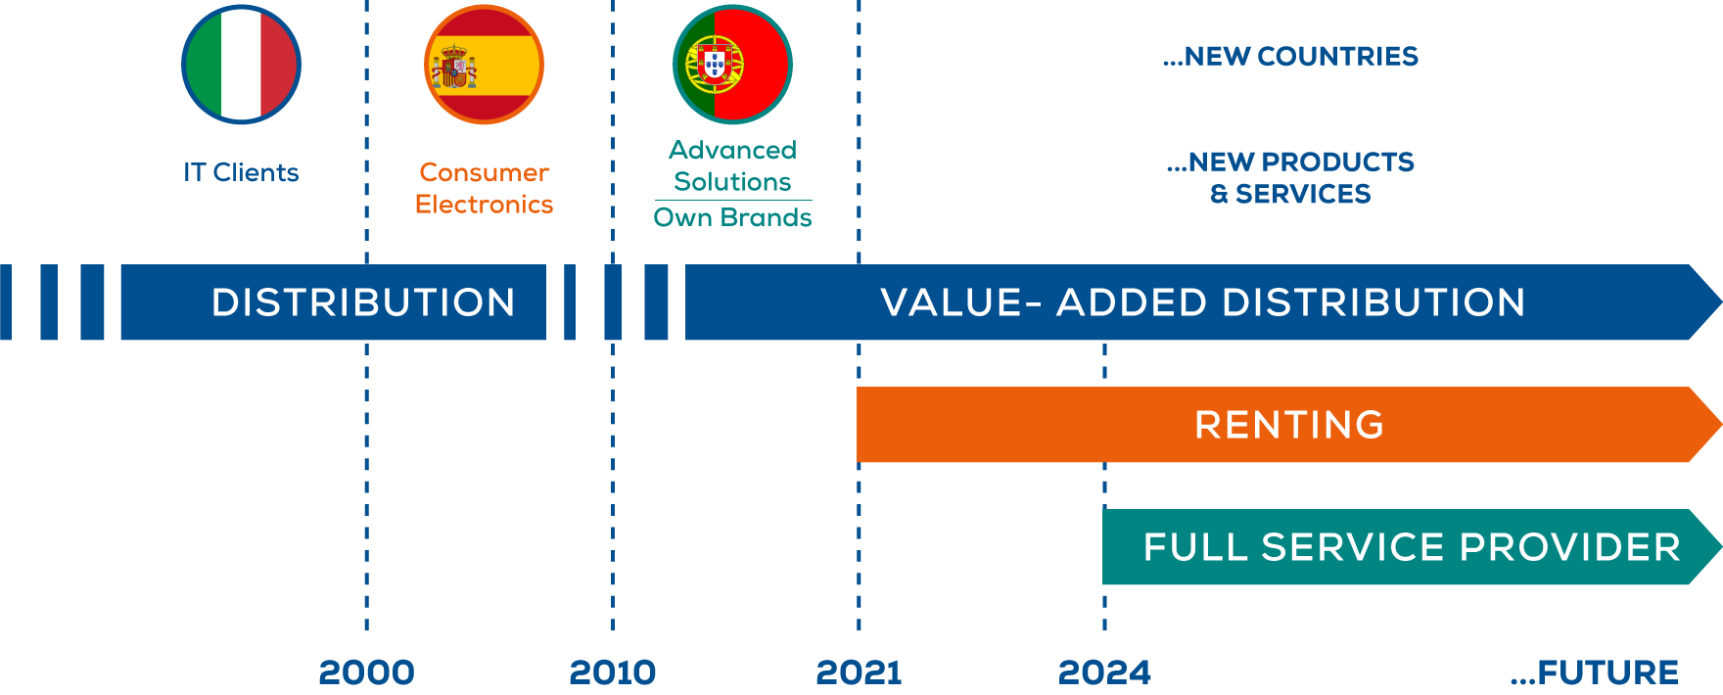
The Path to Full Service Provider
REVENUE
The Group, the undisputed market leader, after 20 years of birth, launches a structural change of the business model with the aim in the next decade of adding to the distribution business a new «full service provider» model with significantly higher added value than the traditional one
CAGR Esprinet Group
8%
EBITDA ADJ.
CAGR Esprinet Group
17%

Slide 19

Company Strategy, The Next Phase of Growth
EVOLVING TO VALUE-ADD DISTRIBUTION
• Customer satisfaction: more differentiation and margins
• Product mix: focus on Solutions and high margin business lines
• Exploiting the Cloud: margins and recurring sales
• Providing more Services to vendors & resellers
ENTERING THE RENTING SPACE
• Leveraging a global cross-industry macro trend
• Getting a bigger portion of the value in the IT value chain
• Drawing new competition boundaries
• Resilient model
CAPITAL EMPLOYED CONTROL
Cash Conversion Cycle < 18 gg days to provide financial flexibility to fund:
• Generous dividend policy
• Organic growth
• M&A
NOPAT
CAPITAL EMPLOYED

Slide 20
Key Growth Drivers
OUR 5 PILLARS
SOURCES OF ADDED VALUE
TOP LINE
PROFITABILITY
Logistic
Credit management
Automated sales and order management processes
Screens
Sales specialist, business developer and pre-sales engineer as support in complex technologies
Marketing activities to promote the sale of complex technologies on behalf of vendors, especially on medium-small customers
Solutions
Ability to affiliate resellers who become sellers of our services
Catalog of services and ability to find the right service provider
Service enablement platform
Services
Ability to choose products and build the catalogue
Ability to select factories
Marketing activities to raise awareness of the own brand
Own Brands
Marketing activities to promote the sale on behalf of vendors especially on medium-small customers
Ability to recruit specialized and vertical retailers (i.e. stationers, home appliance stores, gaming stores, etc.)
Specialized logistic (i.e. for home appliances)
Other Products

Slide 21
A New Stage In Our Elevation Strategy
2022
2021
SCREENS
DEVICES
SOLUTIONS
SERVICES
OWN BRANDS
-6%
+3%
+19%
REVENUE
+40%
-10%
2,893.4
2,722.2
978.4
1,003.5
741.8
882.8
12.4
17.3
64.9
58.4
EBITDA ADJ.
1.01%
1.14%
2.17%
2.28%
3.36%
3.61%
50.81%
36.99%
6.78%
-2.40%
VOLUME
HIGH MARGIN BUSINESS LINES

Slide 22
Strategic Plan 2022/24: KPIs Evolution
A business model revolution moving into a much higher margin space paving the way, giving the intrinsic structure of the rental program, to future massive profitability improvements
Target 2024: increase by roughly 50% our Adj. EBITDA to more than 125 M€ (CAGR 13%)
Capital employed optimization a prerequisite: aiming at keeping the Cash Cycle below 18 days
Solid cash generation and net financial position to support a generous dividend policy and new acquisitions
2022-2024 SALES UP TO 5.6 B€ and ADJ. EBITDA UP TO 125 M€
CAGR 13%
125 M€
120 M€
CONSOLIDATED ADJ, EBITDA
86 M€
OPTIMIZING
DISTRIBUTION BUSINESS
ENTERING
THE RENTING SPACE
ADJ, EBITDA OUTLOOK
5 M€
2021 4,691 M€
2022/24 5,600 M€
2022/24 200 M€^{(*)}
2024 5,600 M€
SALES
(*) Transacted volumes of FY 2024: revenues are booked as part of the 5.6 B€ expected in the same year

Slide 23






An ESG Centric Framework
OUR NEW JOURNEY TO VALUE IS STRONGLY ROOTED IN OUR ESG PURPOSE
GROWTH AND INNOVATION DELIVERED THROUGH A SUSTAINABLE AND INTEGRATED APPROACH TO BUSINESS
ETHICAL MOTIVATION
ESG purposes are consistent with the value system of the Board of Directors and the management team
BUSINESS OPPORTUNITY
There are strong market opportunities on "Environmentally Friendly" product lines such as electric mobility or within some of the NextGenEU funded projects
INCENTIVE FOR INNOVATION
Doing business with an ESG commitment is more complex but stems innovation and in the medium term offers the possibility of generating more value
ACCESS TO A NEW FINANCE
There are new categories of investors or lenders that require a strong ESG strategy
REDUCTION OF RISK PROFILE
In the future it is very likely that governments, or even worse consumers, will punish the companies with weak ESG strategies

Slide 24
THE BACKDROP

Slide 25







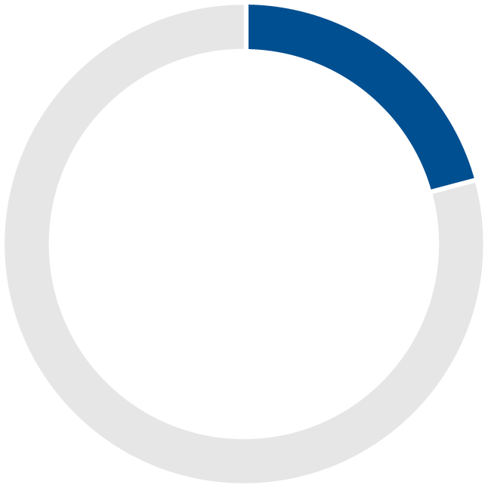
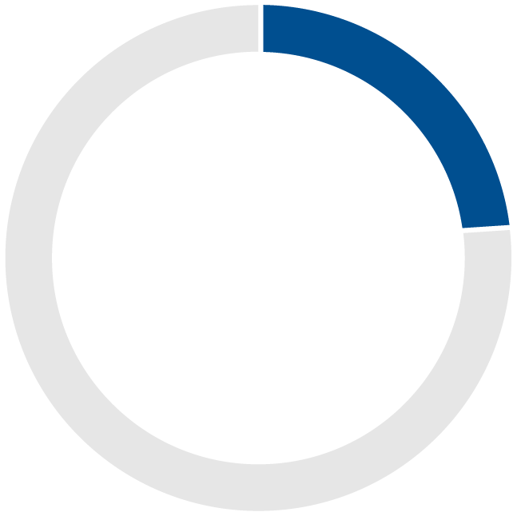
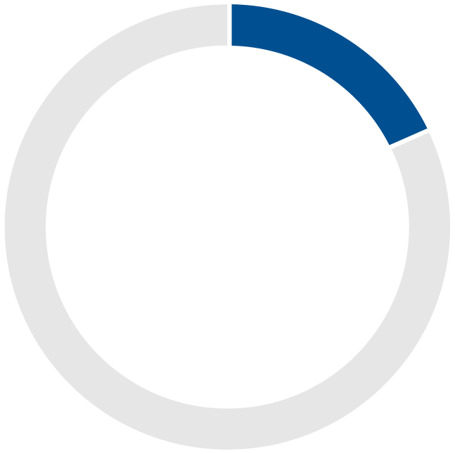
Market Trends
MACROECONOMIC FORECAST
The near-term outlook for the European economy looks brighter than anytime in the last decade^{(*)}
Overview of the GDP Outlook Projections^{(*)}
ICT INDUSTRY
We are already witnessing the acceleration of digital processes, so years of innovation have been reduced to months. The analysis of digitization data confirms the progressive alignment of Italian and Spanish companies to European ones
Percentage of the ICT spending on GDP^{(**)}
3.35%
3.80%
4.41%
4.38%
6.15%
NEXTGenEU, RECOVERY & RESILIENCE PLANS
A golden opportunity for investments in digital transformation: 17.6 B€ cumulated theoretical opportunity for southern Europe distributors, an average of 2.9 B€/year of potential additional volumes
RRF resources allocated to the digital transition 2021-2026
21%
of 191 B€ loans & grants available for Italy
23%
of 69,5 B€ grants available for Spain
18%
of 16 B€ loans & grants available for Portugal
Distribution opportunity^{(***)} 12.0 B€
Distribution opportunity^{(***)} 4.8 B€
AND FOR THE DISTRIBUTOR?
Distributors will remain at centre stage of future vendor go-to-market strategy
The complexity and acceleration of the multicloud solutions adoption means above all the creation of efficient cloud provisioning platforms that only distributors can provide
The role of distributors in buffering stock will be increasingly central and crucial as clearly highlighted by recent supply chain issues
Technology wholesaling continues to be the fastest growing go-to-market strategy for tech manufacturers looking to increase efficiency
^{(*)} Source: IMF, World Economic Outlook, January 2023
^{(**)} Source: Eurostat, data referred to 2019, except for UK referred to 2018
^{(***)} Potential end user spending passed through distribution, net of IT service spending estimated at 50% of total end user spending and considering a weight of distribution in the ICT supply chain of 60%

Slide 26
GDP & ICT Spending
THE THECH INDUSTRY’S PROSPECTS ARE BROADLY POSITIVE
despite the economic crisis and political uncertainty and underlining the fact that the tech sector remains a powerful choice for business growth. As such, organizations should continue to take the opportunity to initiate change by increasing investment in technology. The ICT sector contributes to technological progress, output and productivity growth. Its impact can be examined in several ways: directly, through its contribution to output, employment or productivity growth, or indirectly, as a source of technological change affecting other parts of the economy, for instance.

Slide 27





The Subscription Economy
Riding on two global and cross-industry macrotrends: Subscription Economy & Green Transition
The Subscription Economy addresses the macro theme of consumption against ownership, converting CAPEX into OPEX
The Green Transition advocates for recycling and reuse of end-of-life products, which can be enabled by a rental agreement where the end-of-life product goes back to the original seller being made available for refurbishing and resale, effectively reducing e-waste generation
Multiple industries are moving to rental: car leasing, music & TV streaming services, renting furniture (i.e. Muji or IKEA rental programs), not to mention Regus and similar shared and rented office spaces
The opportunity is massive for the ICT industry, As an example, the Italian association of leasing companies (Assilea) states that 18% of all kind of industrial goods are leased or rented

Slide 28
EXECUTIVE SUMMARY

Slide 29

Executive Summary
1
2
3
4
Historically favourable environment providing significant room for organic growth
ESG focus providing a push for innovation and green transition opportunities
Continuining the journey to a new value creation paradigm:
Accelerating succesful migration from volume to value-add distribution
Entering the renting space
2024 EBITDA Adj. growth vs 2021 of ~ 50% up to 125 M€
Next 3-years targets still heavily reliant on distribution: EBITDA Adj. 120 M€ on 125 M€ of total plan
Since 2025 kick-in of full value of renting model with massive EBITDA expansion opportunity
Long-term journey taking us to a Full Service Provider model with higher EBITDA margin profile
Working capital discipline to provide funds for generous dividend policy and M&A flexibility
5
6
7
8

Slide 30

Group Strategic Priorities
ORGANIC GROWTH From volume to value add distribution
PROFITABILITY IMPROVEMENT Customer satisfaction, Solutions and high margin business lines, Renting and Services to vendors and resellers
GROWTH TROUGH M&A Expansion in other areas of Western Europe in the Solutions& Service segment and in the high margin niches
Growth and innovation delivered through a SUSTAINABLE AND INTEGRATED APPROACH TO BUSINESS

Slide 31
Final Remarks
THE GROUP HAS DELIVERED ON THE PROMISE OF EVOLUTION TOWARDS ADDED-VALUE DISTRIBUTION A PRELUDE TO FURTHER FUTURE ACCELERATIONS IN THE DEVELOPMENT OF THIS NEW BUSINESS MODEL
SALES
EBITDA ADJ.
CAGR
7%
CAGR
19%
(EUR/million)
(EUR/million)
NET PROFIT
DIVIDENDS
CAGR
35%
(EUR/million)
Reference fiscal year
(1)
(2)
Payment suspended in 2020 first year of the Covid 19 pandemic and recovered in 2021
The Board of Directors resolved to propose to the Shareholders' Meeting the distribution of a dividend of Euro 0.54 per share, unchanged compared to the value paid in 2021 and 2022

Slide 32
Q1 2023 RESULTS

Slide 33
Q1 2023 Highlights
GROSS PROFIT MARGINS AND WEIGHT OF BUSINESS SALES IN FURTHER ACCELERATION CONFIRM TRANSITION TO AN ADDED VALUE BUSINESS MODEL
PROFITABILITY INDICATORS
~60% OF TOTAL PROFITABILITY FROM SOLUTIONS & SERVICES
FINANCIAL STRUCTURE
PROGRESSIVELY DECREASING INVENTORY LEVELS
A remarkable growth in gross profit margins which stood at 5.34%, 29bps more than the 5.05% of Q1-22 and 12 bps up sequentially against FY-22.
This increase is even higher considering that the financial cost of factoring in Q1-23 was 23 bps higher than in Q1-22, therefore the Gross Profit Margin improvement before the interest rate impacts has been 52 bps, almost 10% up Y-o-Y
This improvement has been achieved once more thanks to the focus on the high-margin business lines of Solutions & Services now 23% of total sales (17% in Q1-22) and on the business customer segment now 67% of total sales (60% in Q1-22)
The reduction of excess inventory, accumulated due to the combined effect of the reopening of post-pandemic supply chains and the slowdown in consumer demand, continues to be a priority for the Group.
At the same time, the Group is working for a strong Net Debt reduction, keeping payments to suppliers almost stable and managing customer terms as a result of the move towards the business reseller segment

Slide 34

Q1 2023 Sales Evolution
SOLUTIONS & SERVICES OUTPERFORMED THE MARKET WHILST TOTAL SALES WERE DOWN 11% BOTH BECAUSE OF A CHALLENGING SCENARIO AND OF THE ONGOING PHASING OUT OF THOSE PRODUCT/CUSTOMER COMBINATIONS THAT GENERATE LOW VALUE
Q1 2023 sales at 1,018.6 M€ (-11% compared to Q1 2022)
 | Q1 2023
By Country⁽¹⁾ | Esprinet |  | Market⁽²⁾
Italy | 623 M€ | -10% | -1%
Spain | 358 M€ | -14% | +9%
Portugal | 28 M€ | +20% | -3%
By Product Category | Esprinet |  | Market
Screens | 548 M€ | -21% | -7%
Devices | 228 M€ | -6% | -5%
Solutions & Services | 234 M€ | +23% | +18%
Own Brands | 9 M€ | -10% | ⁽³⁾
By Customer Type | Esprinet |  | Market
Retailers & E-tailers | 350 M€ | -28% | -7%
IT Resellers | 698 M€ | -4% | +7%
IFRS15 and other adjustments | (29 M€)
Other Countries: 10 M€ (+0%) in Q1 2023
For all market data, source: Context
Market data not available

Slide 35

Q1 2023 Profitability Evolution
DESPITE THE IMPACT OF INFLATION AND RISING INTEREST RATES THE GRADUAL DIVESTMENT OF LOW-VALUE LINES AND INVESTMENT IN HIGHER VALUE LINES CONTINUES PAVING THE WAY FOR AN ACCELERATED VALUE CREATION JOURNEY
Gross Profit
Q1 2023 Gross Profit at 54.4 M€ (-6% compared to Q1 2022), 5.34% on sales compared to 5.05% of Q1 2022.
EBITDA Adj.
Q1 2023 EBITDA Adj. at 15.4 M€ (-22% compared to Q1 2022); 1.51% on sales (1.73% on sales in Q1 2022).
Cash Conversion Cycle
Closes at 32 days, +6 days compared to Q4 2022 and +19 days compared to Q1 2022.
Net Financial Position
Negative for 341.0 M€, down compared to March 31, 2022 (negative for 89.2 M€) essentially due to the Working Capital.
ROCE
ROCE at 9.6%, compared to 15.2% in Q1 2022. Essentially due to the increasing Average Net Invested Capital, in turn mainly due to the increase in Average Net Working Capital.

Slide 36
P&L Q1 2023 of the Five Pillars
THE SHIFT IN COMPANY FOCUS SOLUTIONS & SERVICES REPRESENT ~23% OF TOTAL SALES AND ~60% OF TOTAL PROFITABILITY WITH A STRONG COMBINED 3.8% EBITDA MARGIN
 | Revenues |  |  |  | EBITDA Adj. |  |  |  | EBITDA Margin Adj.
 | Q1 2023 | Q1 2022 | Delta | Δ % | Q1 2023 | Q1 2022 | Delta | Δ % | Q1 2023 | Q1 2022 | Delta
Screens | 547.7 | 696.2 | -148.5 | -21% | 4.6 | 7.4 | -2.8 | -37% | 0.84% | 1.06% | -0.22%
Devices | 227.9 | 242.8 | -14.9 | -6% | 3.2 | 4.8 | -1.6 | -33% | 1.40% | 1.98% | -0.57%
Solutions | 231.0 | 188.0 | 43.0 | 23% | 7.5 | 7.1 | 0.5 | 6% | 3.25% | 3.75% | -0.50%
Services | 3.0 | 2.4 | 0.6 | 25% | 1.5 | 1.6 | -0.1 | -6% | 50.00% | 66.67% | -16.67%
Own Brands | 9.0 | 10.0 | -1.0 | -10% | -1.4 | -1.1 | -0.3 | -27% | -15.56% | -11.00% | -4.56%
Total | 1,018.6 | 1,139.4 | -120.8 | -11% | 15.4 | 19.7 | -4.3 | -22% | 1.51% | 1.73% | -0.22%
Weight on Revenues & Profitability
3.85%
0.82%
1) All values in € / millions.
2) The costs attributed to each pillar are the direct sales & marketing costs, some categories of general and administrative expenses directly attributable to each business line (i.e. credit insurance costs, warehousing cost) and, for the remaining G&A costs, a distribution proportional to the weight of the business line on the total revenues has been applied. Results not subject to audit.

Slide 37
Q1 2023 P&L Summary
Inflation under control and a good part of interest rates hikes already transferred in pricing, but still way to go to fully absorb the structural changes undergoing the company and the market
(M/€) | Q1 2023 | Q1 2022 | Var. %
Sales from contracts with customers | 1,018.6 | 1,139.4 | -11%
Gross Profit | 54.4 | 57.6 | -6%
Gross Profit % | 5.34% | 5.05%
SG&A | 39.0 | 37.9 | 3%
SG&A % | 3.83% | 3.32%
EBITDA adj. | 15.4 | 19.7 | -22%
EBITDA adj. % | 1.51% | 1.73%
EBIT adj. | 10.8 | 15.6 | -31%
EBIT adj. % | 1.06% | 1.37%
EBIT | 10.8 | 15.6 | -31%
EBIT % | 1.06% | 1.37%
IFRS 16 interest expenses on leases | 0.8 | 0.8 | 5%
Other financial (income) expenses | 2.3 | 0.6 | >100%
Foreign exchange (gains) losses | - 0.5 | 0.4 | <100%
Profit before income taxes | 8.1 | 13.8 | -41%
Profit before income taxes % | 0.79% | 1.21%
Income taxes | 2.2 | 3.7
Net Income | 5.9 | 10.1 | -41%
Net Income % | 0.58% | 0.88%
The Group further improved its gross profit margin performance which stood at 5.34%, a progressive increase compared to 5.05% in the same period last year and to 5.22% recorded in 2022.
This result was achieved once again thanks to the focus on the high-margin business lines of Solutions and Services which consolidated their incidence on total revenues to 23% (17% in the period January-March 2022).
This improvement is particularly remarkable as we experienced a 23 basis points impact from the financial costs of programmes for the assignment of receivables without recourse as a result of the dizzying growth in interest rates: a clear indicator of the capability of transferring inflation and part of financial costs downstream even while reducing the level of stock.
Transport costs now seem to be stable having apparently fully absorbed the inflation.
SG&A: Variable costs stable and fixed costs under control, up only 3%, despite the acquisition last November 2022 of Bludis S.r.l. and the dynamics associated with personnel flows. The weight of operating costs rises to 3.83% (from 3.32% in Q1 2022) mainly due to the currently weak market dynamics.
Increased net financial expenses due to the greater absorption of working capital and growth in interest rates during the last 12 months.
Tax rate essentially unchanged.

Slide 38
Q1 2023 BS Summary
On the balance sheet, the level of inventories is progressively decreasing
(M/€) | 31/03/2023 | 31/03/2022 |  | 31/12/2022
Fixed Assets | 154.1 | 139.9 |  | 151.6
Operating Net Working Capital | 504.5 | 257.7 |  | 261.6
Other current asset (liabilities) | 10.7 | 5.7 |  | (3.2)
Other non-current asset (liabilities) | (25.0) | (23.2) |  | (24.6)
Net Invested Capital [pre IFRS16] | 644.4 | 380.2 |  | 385.4
RoU Assets [IFRS16] | 109.6 | 105.8 |  | 106.9
Net Invested Capital | 754.0 | 485.9 |  | 492.3
Cash | (74.2) | (188.8) |  | (172.2)
Short-term debt | 197.8 | 44.5 |  | 37.1
Medium/long-term debt⁽¹⁾ | 112.2 | 136.5 |  | 119.2
Financial assets | (10.4) | (13.5) |  | (13.5)
Net financial debt [pre IFRS16] | 225.4 | (21.3) |  | (29.4)
Net Equity [pre IFRS16] | 419.0 | 401.5 |  | 414.7
Funding sources [pre IFRS16] | 644.4 | 380.2 |  | 385.4
Lease liabilities [IFRS16] | 115.7 | 110.6 |  | 112.4
Net financial debt | 341.0 | 89.2 |  | 83.0
Net Equity | 412.9 | 396.7 |  | 409.2
Funding sources | 754.0 | 485.9 |  | 492.3
⁽¹⁾ Including the amount due within 1 year
⁽²⁾ Net financial debt pre IFRS 16
Net Invested Capital as of March 31, 2023 stands at 754.0 M€ and is covered by:
Shareholders’ equity for 412.9 M€ (396.7 M€ as of March 31, 2022);
Cash negative for 341.0 M€ (negative for 89.2 M€ as of March 31, 2022).
Operating Net Working Capital impact:
(M/€) | 31/03/2023 | 31/03/2022 |  | 31/12/2022
Inventory | 597.9 | 718.9 |  | 672.7
Trade receivables | 677.3 | 521.2 |  | 701.1
Trade payables | 770.6 | 982.3 |  | 1,112.2
Operating Net Working Capital | 504.5 | 257.7 |  | 261.6
The key area of attention remains the Working Capital.
The Group continues on the path of marked improvement in Working Capital and expects a substantial reduction in Net Debt by the end of the year.
The inventory reduction process that began in the fourth quarter of 2022 continued in the first quarter2023.
The Group is working to ensure almost stable payments to suppliers and to better manage customer payments as a result of the move towards the business reseller segment, whose receivables are not usually covered by factoring programs.

Slide 39
Working Capital Metrics 4-qtr average
Working capital worsening (+6 days) compared to the previous quarter due to:
increase in inventory days (-1 days);
increase in DSO (+5 days);
decrease in DPO (-2 days).
Idays (Inventory Days): 4-qtr average of (quarter-end Inventory / quarterly Sales * 90)
DSO (Days of Sales Outstanding): 4-qtr average of (quarter-end Trade Receivables / quarterly Sales * 90)
DPO (Days of Purchases Outstanding): 4-qtr average of (quarter-end Trade Payables / quarterly Cost of Sales * 90)

Slide 40
Working Capital Metrics quarter-end
Idays (Inventory Days): quarter-end Inventory / quarterly Sales * 90
DSO (Days of Sales Outstanding): quarter-end Trade Receivables / quarterly Sales * 90
DPO (Days of Purchases Outstanding): quarter-end Trade Payables / quarterly Cost of Sales * 90

Slide 41
ROCE Evolution Up To Q1 2023
Average Capital Employed last 5 quarters: equal to the average of “Loans” at the closing date of the period and at the four previous quarterly closing dates
NOPAT Adj last 4 quarters: equal to the sum of the EBIT of the last four quarters less adjusted taxes.
ROCE: NOPAT Adj last 4 quarters / Average Capital Employed last 5 quarters

Slide 42
Tax issues settlement
The Company, as described in the Annual Financial Report 2022, was served by the Italian Tax authorities with four tax assessment for the taxable years 2013-2016 and one claim for taxable year 2017, with which VAT related to certain supplies of goods made to customers declared to be habitual exporters was requested. More in detail, the Italian Tax Authorities, following several tax audits carried out against such customers, claimed that they do not qualify as habitual exporters, and that the same customers took part in a fraudulent tax evasion. Esprinet has never been considered part of this mechanism but in relation to which it would have an objective responsibility since it did not carry out adequate controls on these customers. Accordingly, the Italian Tax Authorities challenged to Esprinet Euro 77 million as higher VAT, which, together with penalties and interest, leads to an overall potential risk of more than Euro 220 million.
It should be noted that the Company, in the past, received several opinions from leading law firms, which confirmed the correctness of its behavior. However, considering that the tax litigation, over three levels of judgment, may last more than 10 years, and that even if the litigation is pending advance payments should be made to the Italian Tax Authorities, the Board of Directors, especially to avoid the risk of potentially immobilize these significant amounts over the next few years, has deemed appropriate to start with the Italian Tax Authorities a procedure for a settlement.
Om May 22, 2023, for mere settlement purposes of a potential long-lasting tax dispute, the Company has signed an agreement with the Italian Tax Authorities aimed at settling the VAT claims in relation to tax periods from 2013 to 2017. Based on the comprehensive agreement reached, the Company will have to pay a total amount of approximately 33.2 million euros. Therefore, compared with the total original claim of more than 220 million euros, the Company will bear an actual burden, in terms of VAT and related penalties, of less than 14 percent of that claim, plus accrued interest. The amounts due will be paid by the Company in installments over a maximum of five years with equal quarterly payments. With the signing of this agreement, the Company has definitively avoided the risk of potentially immobilize these significant amounts over the next few years.

Slide 43
GUIDANCE 2023

Slide 44
2023 backdrop & priorities
The backdrop
Esprinet Key Priorities
Headwinds
Geopolitical tension
Persistence of high inflation as well as interest rates increases weigh on return to growth. Forward-looking indicators suggest disinflation in second half but negative short-term momentum still very strong
Opportunities
Public investment in digitalization is on the rise for the first time in a decade and implementation of Next Gen EU will strengthen
Product refresh on a larger installed base of users starting end of the year
What to watch
Economic outlook: risk of recession or GDP recovery? The uncertainty of the macroeconomic scenario affects business confidence and investments
Shifting from energy risks to credit/financial risks?
Priorities
The Group, consistently with the 2022-2024 Strategic Plan, will continue to pursue its objectives mainly aimed at
the definitive transformation of the value-added distribution model, phasing out the lowest value-add combinations of products/customers and therefore potentially accepting market share losses while relentlessly focusing on the progressive improvement of gross profit margins;
finding value in lower profitability lines such as telephones and computers (so called “Screens”) only when optimal management of working capital levels is achievable;
looking for new growth opportunities, also through M&A, in the Solutions and Services segments in Western European countries.
The Group also intends to continue on the path of the desired strong improvement in the level of net working capital absorption by the end of the year, consequently returning to higher levels of ROCE.

Slide 45
Profitability Track Record & Guidance
DIGITAL TRANSFORMATION DRIVES STRONG IT SPENDING AND CLEAR AND CONSISTENT GROUP STRATEGY AIMS AT FURTHER GROWTH IN THE HIGH VALUE-ADD PRODUCTS/CUSTOMERS SEGMENTS OF THE IT INDUSTRY
Last 10 years EBITDA ADJ.
Guidance
For 2023, industry analysts are almost unanimous in predicting a low single digit increase in demand in the Group's reference countries and a strong rebound as early as 2024.
There is also agreement that the strongest growth is expected in the Software and Infrastructure spending, and consumer demand will continue to be under pressure.
In consideration essentially of the challenging backdrop as well as the results obtained in the first quarter of 2023 and the uncertain expectations for the following ones in terms of sales volumes mainly in the consumer segment, the Group estimates for 2023:
EBITDA Adjusted between Euro 85 and 95 million euro
compared to 90.7 million euro last year
85-95

Slide 46
GOVERNANCE

Slide 47
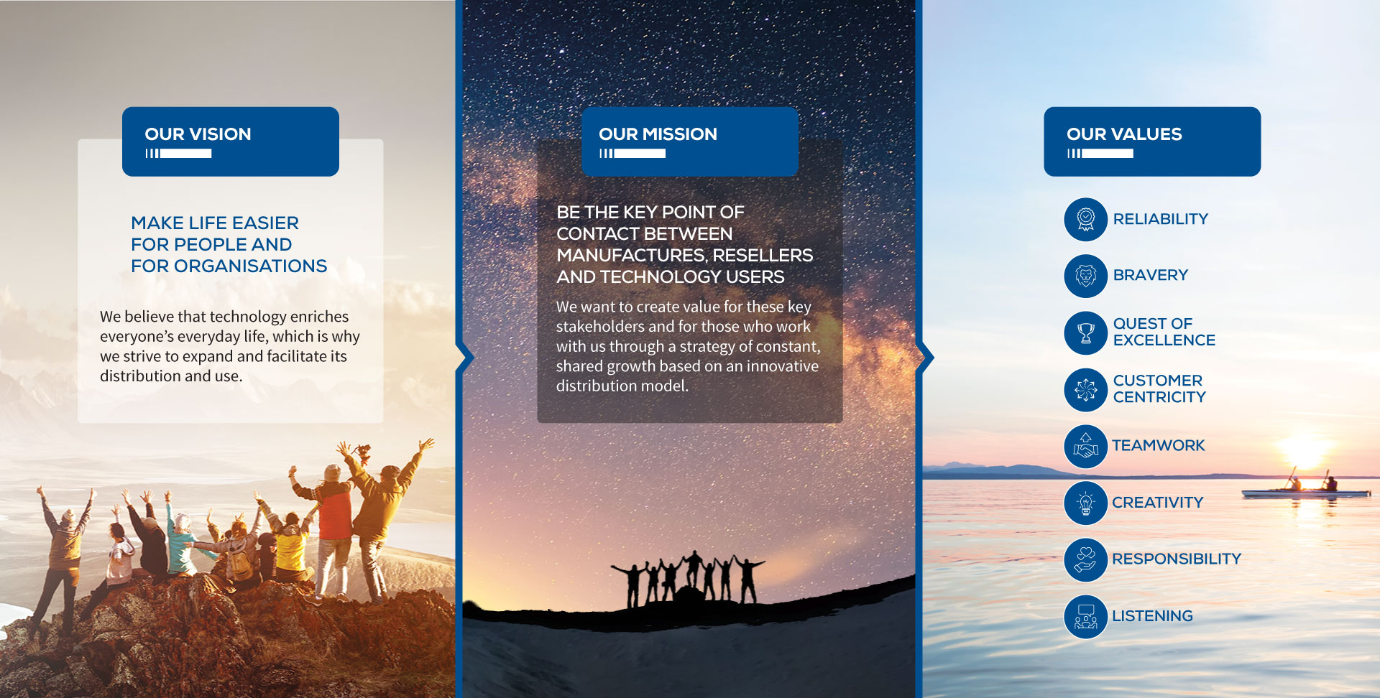

Slide 48
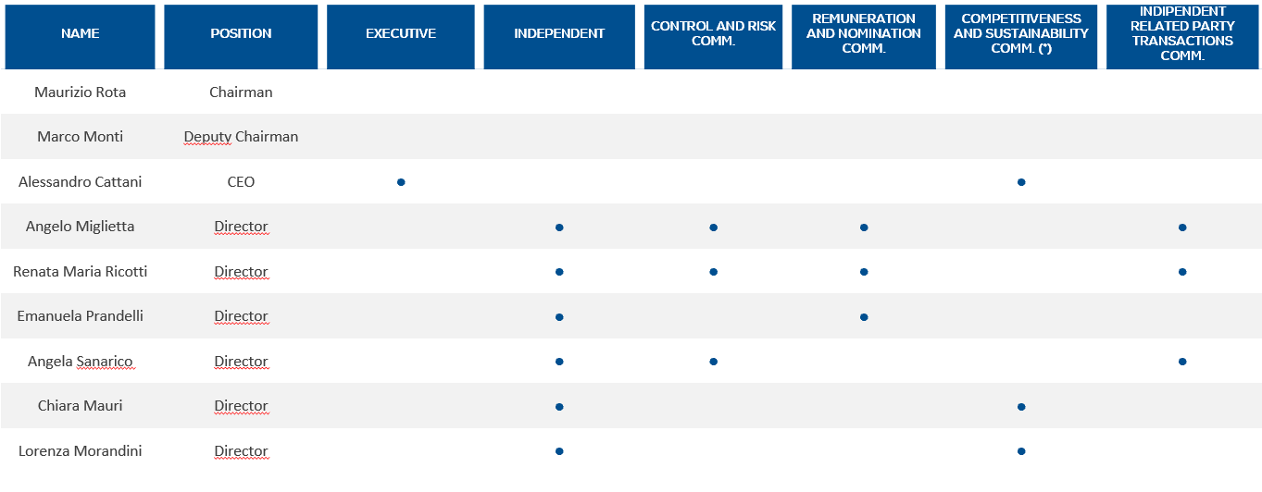
Board Of Directors
4 Men
5 Women
(* ) Giovanni Testa, Chief Operating Officer of Esprinet, is the fourth member of the committee

Slide 49
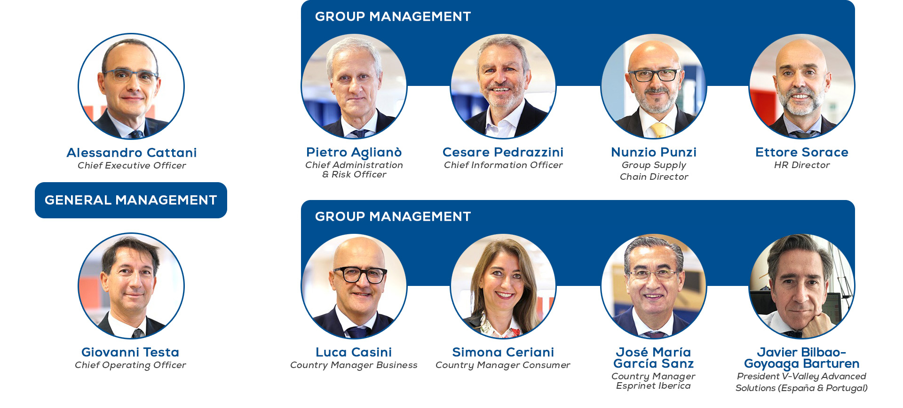
Management

Slide 50
Code & Principles
Code of Ethics
Code of Conduct
“231” Organisation Model
The Code of Ethics applies to all activities carried out by or in the name and on the behalf of Esprinet S.p.A. and its subsidiaries.
The Code of Ethics:
establishes the guidelines of conduct and regulates the set of rights, duties and responsibilities that the Group expressly assumes with its stakeholders;
defines the ethical criteria adopted for a correct balance between expectations and stakeholder interests;
contains principles and guidelines for conduct in areas of potential ethical risk.
The Esprinet Group wishes to establish trade relations with its vendors and business partners based on transparency, correctness and business ethics. The development of transparent and lasting relationships with vendors, attention to quality, safety and respect for the environment and compliance with existing regulations are objectives to be pursued with a view to consolidating the value created in favour of stakeholders.
Therefore, in connection with the Code of Ethics adopted by Esprinet S.p.A. and its subsidiaries, the Group has defined a Code of Conduct designed to guide relations throughout its supply chain.
This document, entitled “Organisation and Management Model pursuant to “Legislative Decree 231/2001” (hereinafter called “the Model”), has been drawn up to implement the terms of ss. 6.1.a and 6.1.b, 6.2, 7.2 and 7.3 of Legislative Decree no. 231 of 08.06.2001 (hereinafter called "the Decree").
The Model is the management reference document which institutes a corporate prevention and control system designed to prevent the offences specified in the Decree from being committed. The Ethical Code enclosed summarizes the values, correctness and loyalty by which the Esprinet Group is inspired and constitutes the base of our Organizational, Administrative and Control Models. The Code has been adopted by the company in order to prevent any occupational hazards or risks in view of the D. Lgs. 231/2001 law.
On April 15th, 2020 the companies Board of Directors accepted a new and updated version of the Organizational, Administrative and Control Models which substitutes the previous version approved on September 11th, 2018.

Slide 51
Star Requirements
Esprinet Spa listed in the STAR Segment* voluntarily adhere to and comply with strict requirements
High transparency, disclosure requirements and liquidity (free float of minimum 35%)
Corporate Governance in line with international standards
*The market segment of Borsa Italiana’s equity market (MTA-Mercato Telematico Azionario). Dedicated to mid-size companies with a capitalization less than 1.0 euro/bln
Major requirements for shares to qualify as STAR status
Interim financial statements available to the public within 45 days from the end of first, third and fourth quarter
Make the half-yearly report available to the public within 75 days of the end of the first half of the financial year
Favourable auditor’s report on their latest individual and consolidated annual financial statements
Consolidated annual financial statements not challenged by Consob
Bi-lingual publication on the websites
Mandatory presence of a qualified investor relator and a “specialist”
Adoption of the models provided for in art. 6 of Leg Decree 231/2001
Application of Corporate Governance Code
Additional requirements in the article 2.2.3 of Borsa Italiana guidelines
Esprinet is fully compliant⁽¹⁾ with the Code of self-discipline (Corporate Governance Code).
⁽¹⁾ With minor exceptions which are explained as permitted by the Code in the “Corporate Governance” section of the society

Slide 52




Shareholders & Analyst Coverage
DECLARANT & DIRECT SHAREHOLDER | % ON ORDINARY CAPITAL | % ON VOTING CAPITAL
Montinvest S.r.l. | 16.33% | 16.33%
Uliber S.r.l. ⁽¹⁾ | 11.38% | 11.38%
Axopa S.r.l. (Maurizio Rota and Alessandro Cattani) | 9.90% | 9.90%
Own shares | 2.01% | 2.01%
Floating | 60.38% | 60.38%
ANALYST COVERAGE
Italian Stock Exchange (PRT:IM)
Number of shares: 50.42 million
YTD Average volume of 237,399 shares per day ^{(*)}
(*) Period: January 1 – May 31, 2023

Slide 54
Annex

Slide 55
P&L FY 2022 of the Five Pillars
SOLUTIONS & SERVICES SALES EXCEEDED EURO 900 MILLION WITH A STRONG 4.2% EBITDA MARGIN YoY REVENUE GROWTH OF 19% (TWICE 2018 VOLUMES). THE SINGLE HIGHEST CONTRIBUTOR IN TERMS OF EBITDA ADJ..
 | Revenues |  |  |  | EBITDA Adj. |  |  |  | EBITDA Margin Adj.
 | 2022 | 2021 | Delta | Δ % | 2022 | 2021 | Delta | Δ % | 2022 | 2021 | Delta
Screens | 2,722.2 | 2,893.4 | -171.2 | -6% | 30.9 | 29.3 | 1.6 | 5% | 1.14% | 1.01% | 0.12%
Devices | 1,003.5 | 978.4 | 25.1 | 3% | 22.9 | 21.2 | 1.7 | 8% | 2.28% | 2.17% | 0.12%
Solutions | 882.8 | 741.8 | 141.0 | 19% | 31.9 | 24.9 | 7.0 | 28% | 3.61% | 3.36% | 0.26%
Services | 17.3 | 12.4 | 4.9 | 40% | 6.4 | 6.3 | 0.1 | 2% | 36.99% | 50.81% | -13.81%
Own Brands | 58.4 | 64.9 | -6.5 | -10% | -1.4 | 4.4 | -5.8 | -132% | -2.40% | 6.78% | -9.18%
Total | 4,684.2 | 4,690.9 | -6.7 | 0% | 90.7 | 86.1 | 4.6 | 5% | 1.94% | 1.84% | 0.10%
Weight on Revenues & Profitability
4.2%
1.4%
1) All values in € / millions.
2) The costs attributed to each pillar are the direct sales & marketing costs, some categories of general and administrative expenses directly attributable to each business line (i.e. credit insurance costs, warehousing cost) and, for the remaining G&A costs, a distribution proportional to the weight of the business line on the total revenues has been applied. Results not subject to audit.

Slide 56
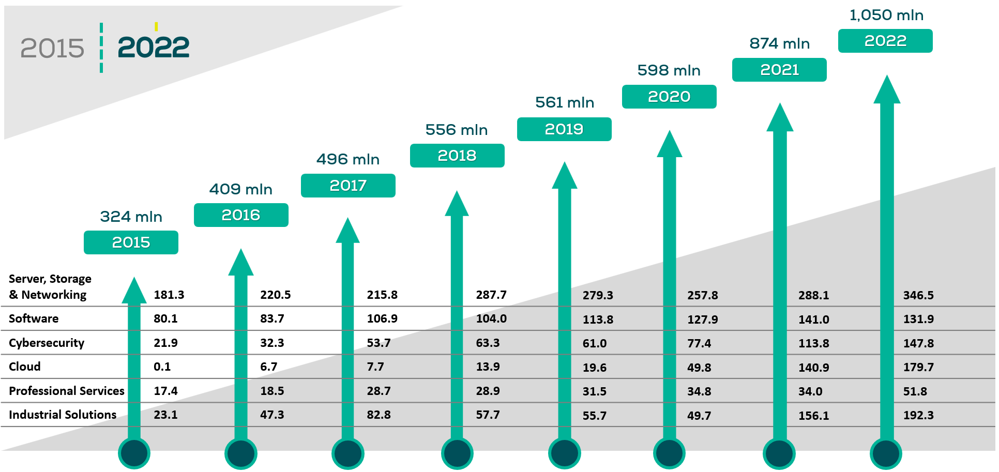

The V-Valley Solutions division
SOLUTIONS & SERVICES SALES EXCEEDED EURO 1 BILLION^{(*)} WITH A STRONG 4.2% EBITDA MARGIN YoY REVENUE GROWTH OF 19% (TWICE 2018 VOLUMES). THE SINGLE HIGHEST CONTRIBUTOR IN TERMS OF EBITDA ADJ.
(*) Euro 900 million after the application of IFRS 15

